Slide 1

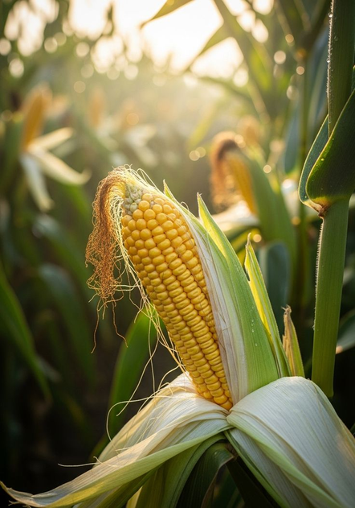


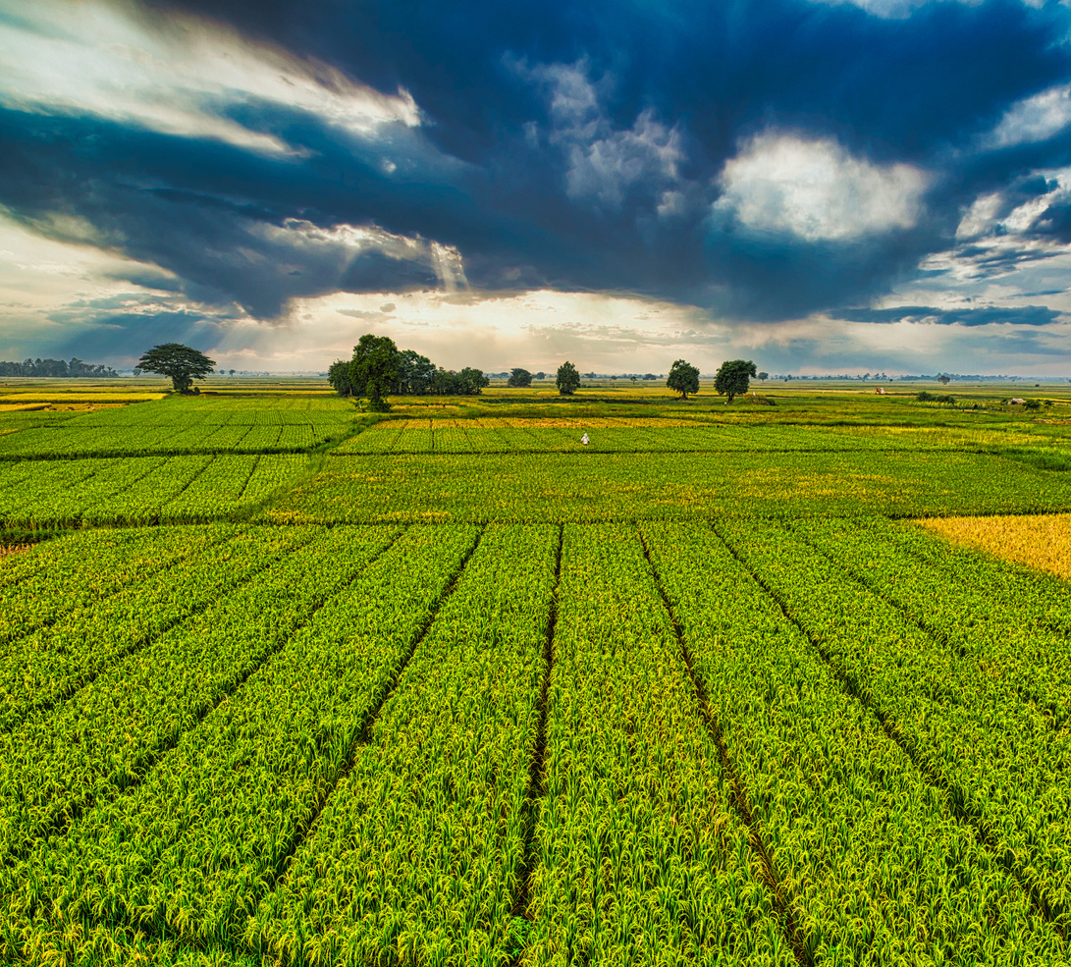
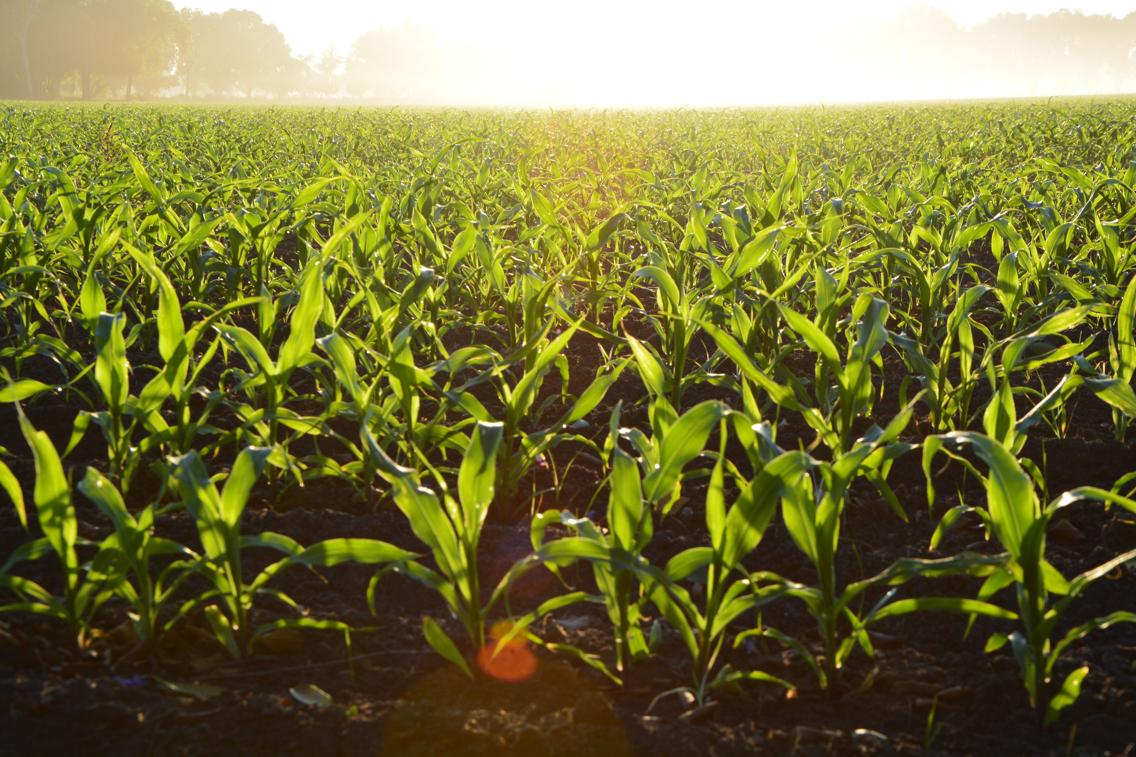
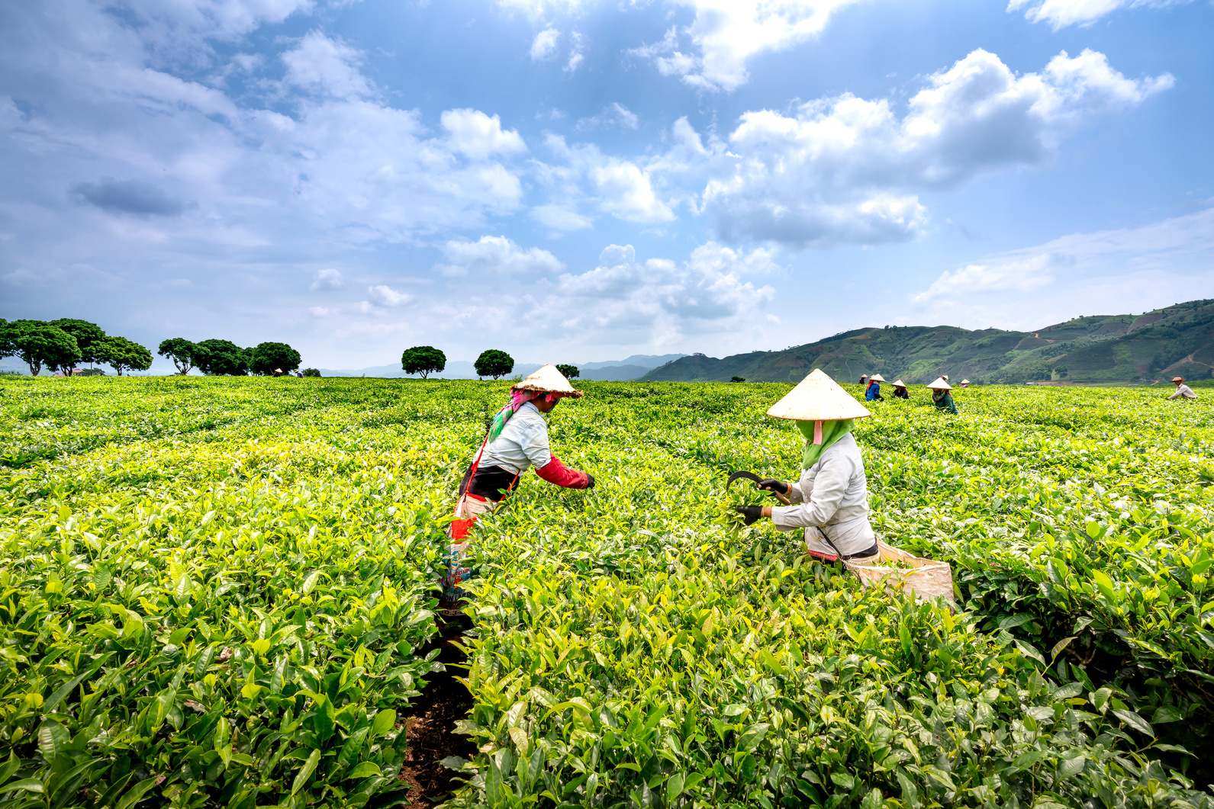
MAIZE CROP YIELD PREDICTION AND ADVISORY SYSTEM
21/04428 NJOROGE HALDLINE MUKAMI
PROJECT SUPERVISOR:GLADYS MANGE
BDS 4105 FINAL YEAR PROJECT
MAIZE CROP YIELD PREDICTION AND ADVISORY SYSTEM

Slide 2
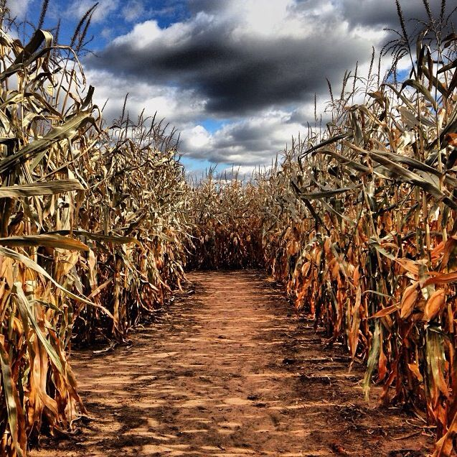

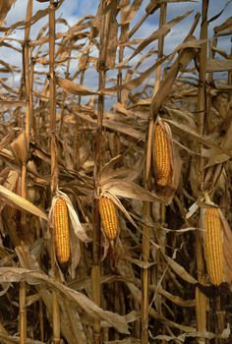
INTRODUCTION
Maize is Kenya’s main staple food and a vital part of the country’s economy. Although several studies and models have explored maize yield prediction, most focus only on forecasting production. However, maize production remains unstable due to unpredictable rainfall, poor soil fertility, and limited access to modern technologies, which continue to threaten food security and farmer livelihoods. This project, the Crop Yield Prediction and Advisory System (CYPAS), builds on existing prediction efforts by introducing an advisory component that provides farmers and policymakers with actionable insights and practical recommendations for improving maize yield and sustainability.

Slide 3
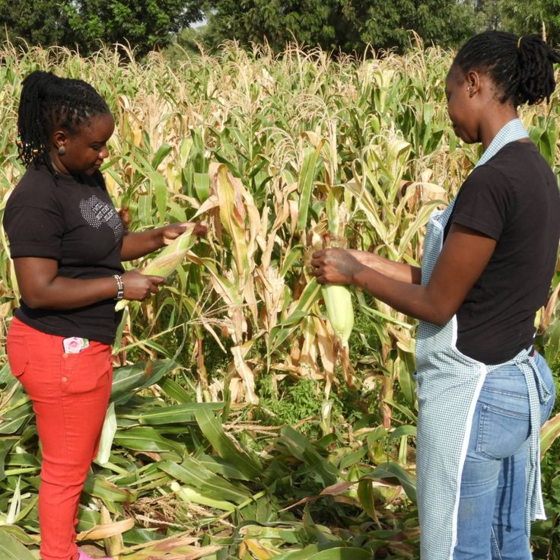
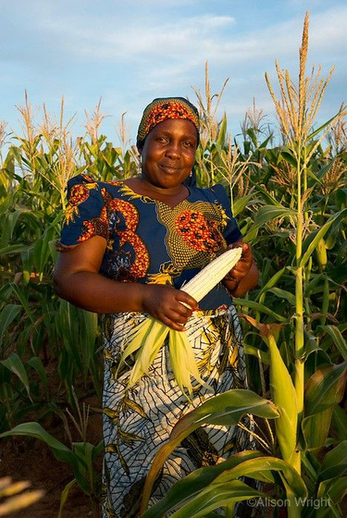
BACKGROUND
Maize remains a key staple food in Kenya, yet yields have stayed low and unstable due to erratic rainfall, soil degradation, and the effects of climate change. Most smallholder farmers still rely on traditional methods rather than data-driven tools, limiting their ability to make timely and informed farming decisions.
With the growing availability of open agricultural data—such as satellite imagery, weather data, and soil maps—machine learning now offers a way to predict yields and provide advisory insights. The Crop Yield Prediction and Advisory System (CYPAS) bridges data science and practical farming by delivering localized, easy-to-understand recommendations that support sustainable agriculture and strengthen food security in Kenya.

Slide 4
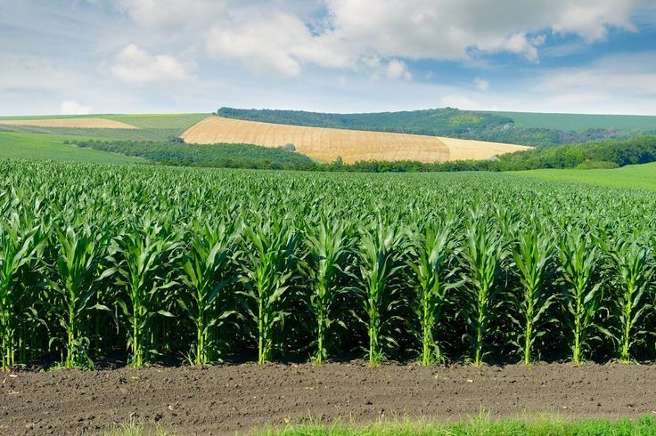
PROBLEM STATEMENT
Maize production in Kenya has been highly unstable over the past decade, despite its central role as the nation’s staple food crop. Unpredictable weather patterns, declining soil fertility, pest outbreaks, and limited adoption of modern technologies have caused frequent yield fluctuations—resulting in food shortages, increased imports, and reduced farmer income.
Current agricultural systems focus mainly on data collection and reporting, offering little predictive or advisory support. Most farmers still depend on outdated experience-based methods, which are unreliable under changing climatic conditions.
There is therefore a need for a data-driven, predictive, and user-friendly system that can forecast maize yields and provide actionable insights. The Crop Yield Prediction and Advisory System (CYPAS) seeks to fill this gap by applying machine learning to analyze weather, soil, and historical production data, delivering both yield predictions and tailored recommendations to enhance productivity and food security.

Slide 5
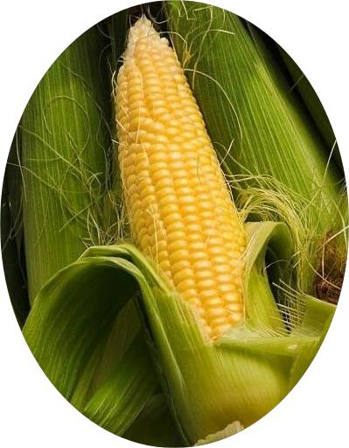
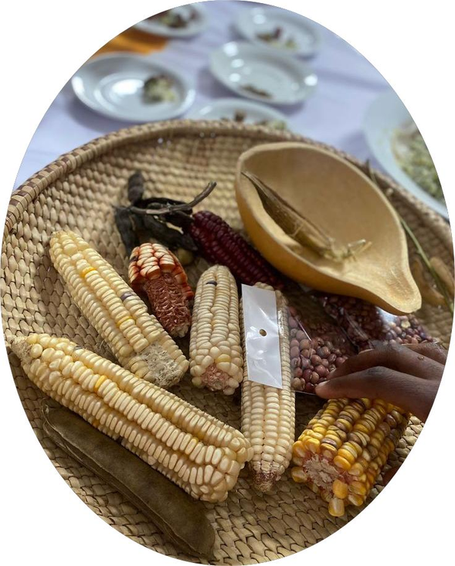

The Crop Yield Prediction and Advisory System (CYPAS) is a web-based platform that uses machine learning to predict maize yields across Kenyan counties and provide actionable farming advisories. It integrates weather, soil, satellite, and past yield data to generate accurate, localized forecasts and practical recommendations for farmers and planners.
Key Highlights
Integrates multi-source agricultural data for prediction.
Uses advanced models like Random Forest and XGBoost.
Provides simple, data-driven advisories on planting and fertilizer use.
Displays interactive charts and maps for visualization.
Offers a user-friendly web interface for easy access.
CYPAS goes beyond prediction — it empowers farmers and decision-makers with timely, insight-based guidance to improve productivity and promote food security in Kenya.
PROPOSED SOLUTION
SLIDE 5

Slide 6
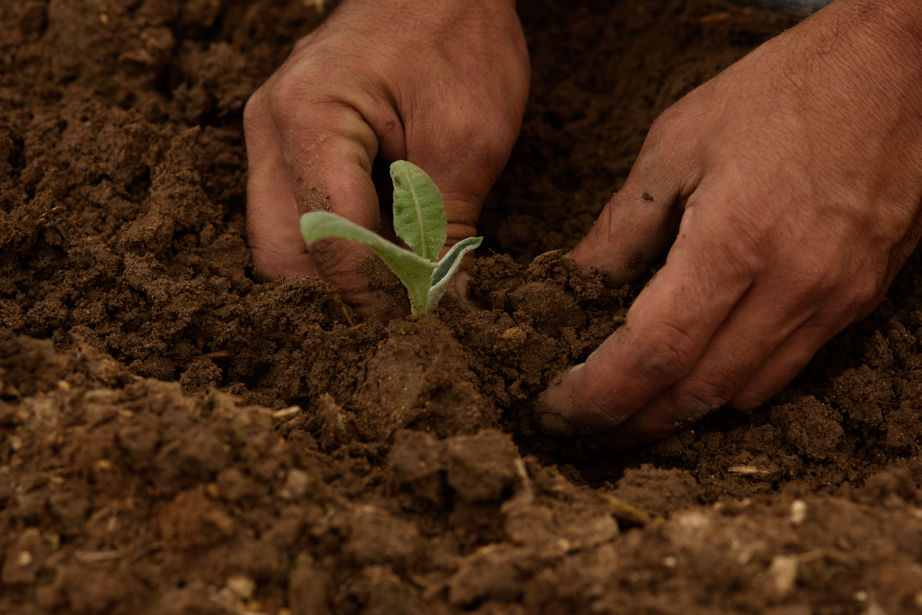
PROJECT OBJECTIVE
General Objective:
To design and develop a machine learning–based Crop Yield Prediction and Advisory System (CYPAS) that predicts maize yields in Kenya using multi-source data and provides accurate forecasts and practical farming advice through a web platform.
Specific Objectives:
To collect and preprocess weather, soil, and historical yield data for maize prediction.
To build and evaluate machine learning models such as Random Forest and XGBoost for accurate yield forecasting.
To develop a Streamlit web application for interactive data input, prediction, and visualization.
To integrate an advisory module offering recommendations on planting, irrigation, and fertilizer use.
To test, deploy, and assess the system’s performance and usability in supporting data-driven farming decisions.

Slide 7
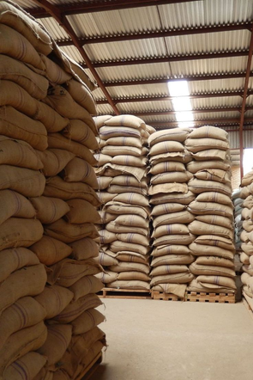
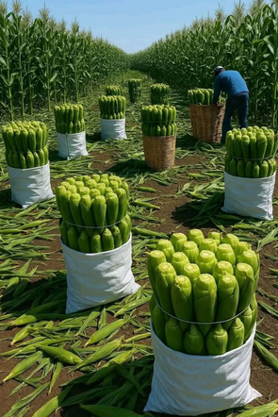
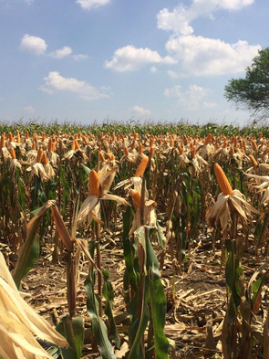
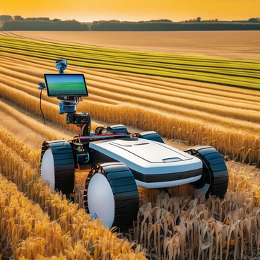
Recent studies highlight the growing role of machine learning and data-driven systems in improving agricultural productivity and yield forecasting. Traditional field-based methods are often slow, expensive, and prone to human error — prompting a shift toward automated, data-integrated approaches.
Research by Shastry et al. (2022) and Ghosh et al. (2021) demonstrated that models like Random Forest and XGBoost can accurately predict crop yields using weather, soil, and satellite data, achieving strong performance (R² > 0.8). These studies show that combining multiple data sources improves accuracy and reliability.
In Kenya, most agricultural systems still focus on climate reporting rather than yield forecasting, leaving a gap in actionable, predictive tools. The proposed CYPAS system seeks to fill this gap by integrating machine learning, remote sensing, and visualization to deliver both yield predictions and advisory insights, supporting data-driven farming and food security.
LITERATURE REVIEW
Shastry et al., 2022; Ghosh et al., 2021; FAO, 2023.

Slide 8
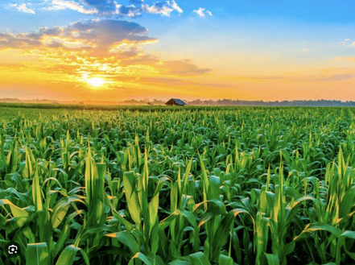
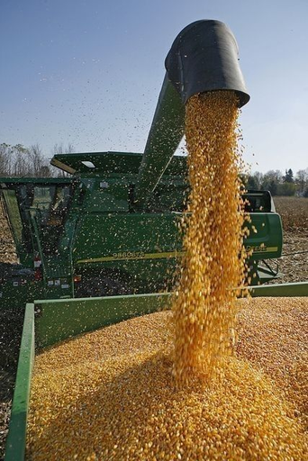
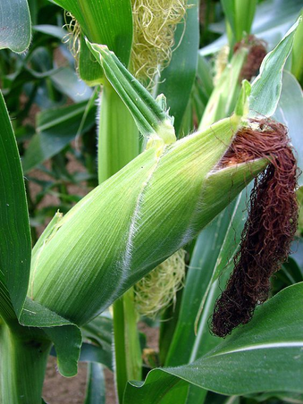
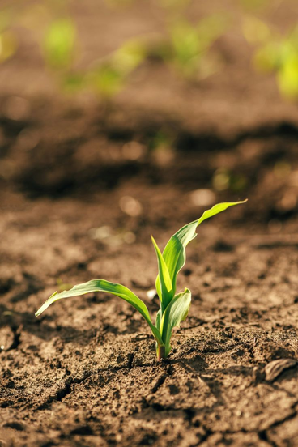
SIGNIFICANCE OF STUDY
Empowers farmers with data-driven decisions for improved yield and reduced risk.
Provides predictive insights for better planning of planting, irrigation, and fertilizer use.
Supports policy and resource planning with reliable yield data.
Promotes food security and sustainable agriculture in Kenya.
Advances the adoption of machine learning in agricultural innovation.

Slide 9

METHODOLOGY
This study combines both research and system development methodologies to ensure the Crop Yield Prediction and Advisory System (CYPAS) is scientifically valid, technically sound, and practically useful.
The methodology is divided into two parts — Research Methodology (data and modeling process) and Development Methodology (system implementation process).
Research Methodology
Approach: Quantitative and exploratory
Cycle / Process:
Data Collection – Gather data from FAO (yield), NASA POWER (weather), SoilGrids (soil)
Data Cleaning & Integration – Standardize and merge datasets
Feature Engineering – Extract predictors (rainfall, NDVI, temperature)
Model Training & Evaluation – Apply Random Forest and XGBoost; test with R², RMSE, MAE
Visualization & Interpretation – Use graphs, charts, and heatmaps to show insights .
Development Methodology (Agile Approach)
Approach: Agile — iterative, flexible, and user-focuse.
Cycle / Process:
Planning – Define user needs & project scope
Design – UI layout and data flow setup
Implementation – Develop model and Streamlit interface
Testing – Evaluate system functionality and accuracy
Deployment – Launch web app and collect user feedback
Review & Improvement – Adjust based on performance

Slide 10


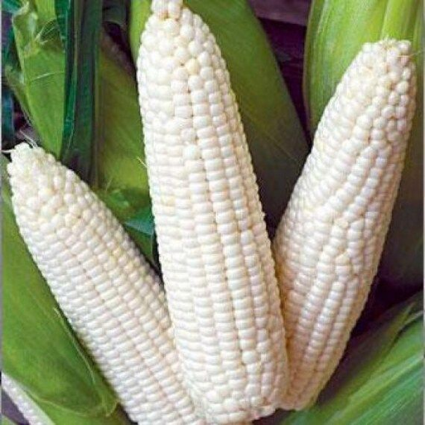
BUDGET AND RESOURCES
The implementation of the Crop Yield Prediction and Advisory System (CYPAS) requires minimal financial input since most tools, datasets, and hardware resources are readily available. The main costs arise from internet usage and general project logistics.
CATEGORY | DESCRIPTION | ESTIMATED COST(KHS)
HARDWARE | Personal laptop for data analysis, modeling, and system development (already available) | 0
SOFTWARE&TOOLS | Python, Streamlit, Scikit-learn, Plotly, Folium — all open-source and free | 0
DATA SOURCES | Open agricultural datasets from FAO, NASA POWER, and SoilGrids/OpenLandMap | 0
INTERNET&HOSTING | Internet access for research, data collection, model testing, and deployment | 2000
MISCELLANEOUS EXPENSES | Printing, documentation, and minor operational or communication costs | 1500
TOTAL ESTIMATED COST |  | 3500

Slide 11

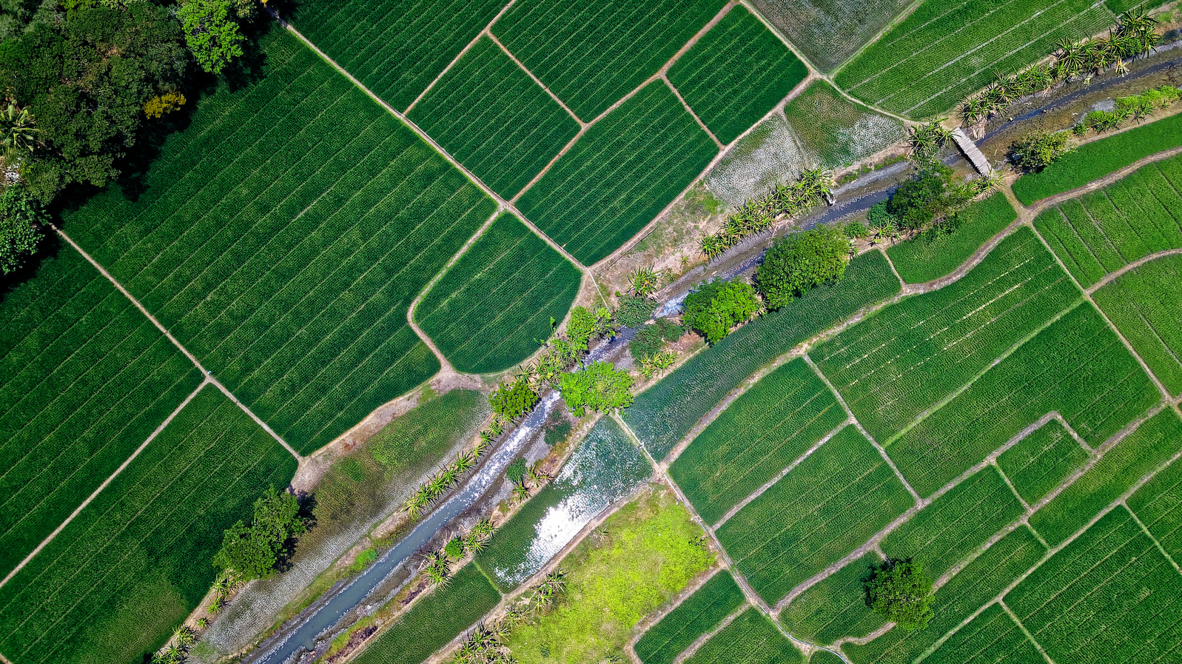
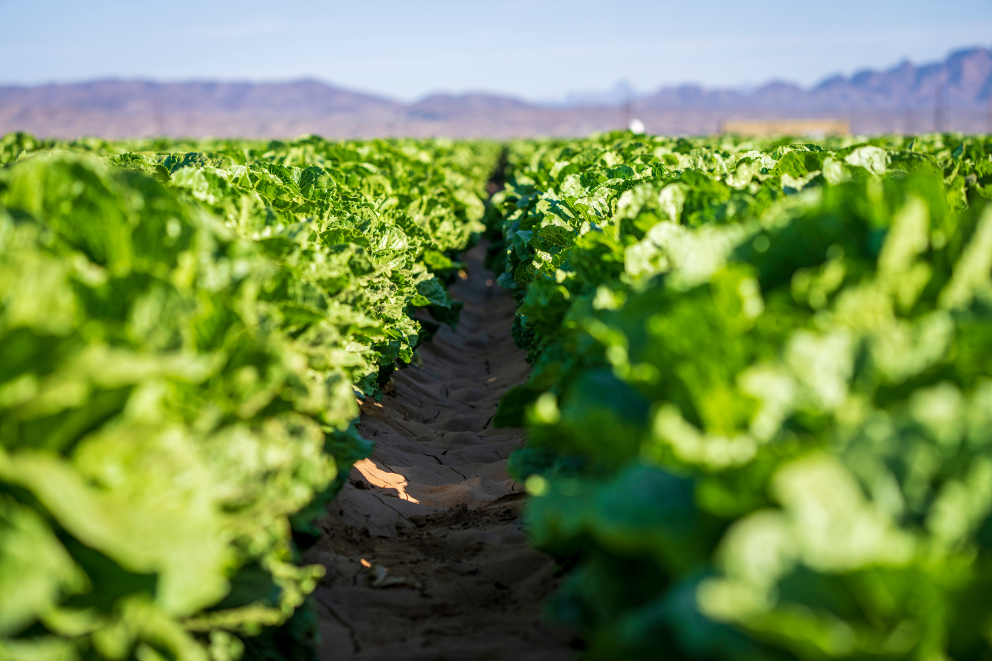
NONO | TTASK | DURATION | _planed sta-datedate | Actual Sta - Date | Planned - Completion Date | Actual - Completio n Date | Deliverables
11 | PROPOSAL WRITING | 2 WEEKS | 22/9/202 | 8/10/2025 | 3/10/2025 | 16/10/2025
22 | PROPOSAL PRESENTATION | 1 WEEK | 6/10/2025 |  | 99/10/2025
33 | SRS | 2 WEEKS | 9/10/2025 |  | 24/10/2025
4 | SDS | 2 WEEKS | 24/10/2025 |  | 21/11/2025
5 | PROGRESS REPORT | 1 WEEK | 28/11/2025 |  | 31/11/2025
6 | TESTING AND EVALUATION | 2 WEEKS | 11/1/2026 |  | 14/2/2026
7 | SSYSTEM DOCUMENTATION | 1 WEEK | 16/3/2026 |  | 21/3/2026
8 | SYSTEM PRESENTATION | 1 WEEK | 23/3/2026 |  | 27/3/2026
9 | USER MANUAL | 1 WEEK | 28/3/2026 |  | 30/3/2026
10 | FINAL REPORT AND SUBMISSION | 1 WEEK | 10/4/2026 |  | 10/4/2026
PROJECT SCHEDULE

Slide 12

REFERENCES
References / Sources
FAO (2023) – Crop yield data
NASA POWER (2023) – Weather and climate data
SoilGrids (2023) – Soil composition and fertility data
Breiman, L. (2001) – Random Forest algorithm
Chen & Guestrin (2016) – XGBoost model
Chapman et al. (2000) – CRISP-DM Framework
Scikit-learn, Streamlit & Plotly (2024) – Model development and visualization tools

Slide 13
Thank You!
Let’s grow a greener future together!

